Slide 1
Uncertainty
and Validation
in digital soil mapping

Slide 2
What is uncertainty?
Soil mapping involves making predictions at locations where no soil measurements were taken
This inevitably leads to prediction errors because soil spatial variation is complex and cannot be modeled perfectly
In fact, we may even be uncertain about the soil at the measurement locations because no measurement method is perfect and uncertainty also arises from measurement errors
Uncertainty is an acknowledgement of error

Slide 3
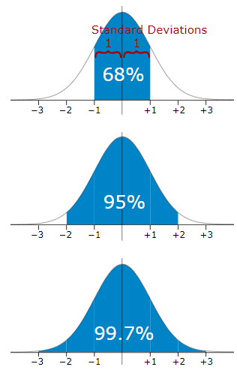
Uncertainty of the linear model
In the presence of uncertainty, we cannot identify a single, true values for each pixel of the map.
But we can identify all possible values and a probability for each one - to characterise the uncertain variable with a probability distribution.
If the distribution is normal, it is easy to construct a confidence interval, where e.g. we are certain with 95% confidence that the true value will be within 2 standard deviations from the mean (prediction)

Slide 4
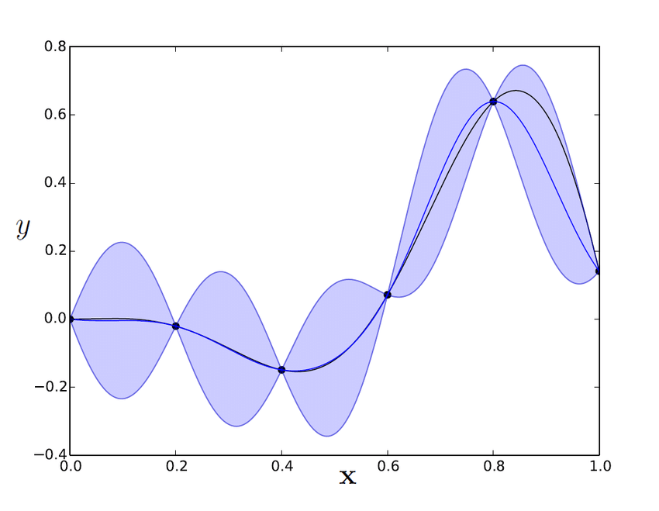
Uncertainty of Kriging
Kriging reduces uncertainty around the sampling points where we have observations;
The more distance from the sampling points - the higher uncertainty.

Slide 5
Uncertainty of Regression Kriging
For Regression Kriging, uncertainty of the model includes both Linear component and Kriging component.
We can use standard deviation as a quantification of uncertainty in every point of the map, and build confidence intervals.
For Regression Kriging, standard deviation can be easily derived as a square root of kriging variance:
# Make an uncertainty estimation as a map of standard deviations
# Standard deviation is the square root of kriging variance
RKsd <- sqrt(raster(pred_gstat, layer='var1.var'))
plot(RKsd, col= topo.colors(255))
writeRaster(RKsd,'02-Outputs/MKD_OCS_RK_sd.tif', overwrite=TRUE)

Slide 6
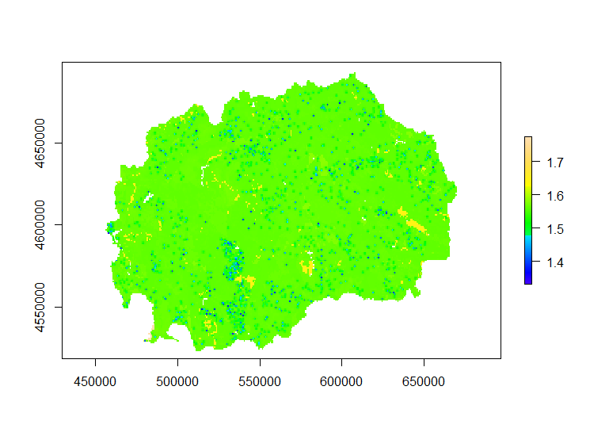
Map of standard deviations

Slide 7
Uncertainty of Random Forest
Machine learning models typically yield more accurate predictions but quantification of the associated uncertainty is more difficult.
Random Forest is a non-linear model, the residuals may be not normally distributed, therefore we cannot quantify uncertainty in the same way as for Regression Kriging.

Slide 8
Uncertainty of Random Forest
The research for the best way to quantify uncertainty of Random Forest is ongoing.
The example R code to realize this approach is included in the SOC mapping Cookbook (FAO, 2018) and in the training material
Be aware that the quantile regression forests algorithm is very computationally intensive, and requires a lot of processing time and computer memory.

Slide 9
Uncertainty of Random Forest
Approach to estimate total uncertainty, composed of:
the sensitivity of the model to available data
the the uncertainty of the model
To analyze the sensitivity of the model to available data we need to randomly split the data several times (e.g., 10 or more, is possible until the variance stabilizes) in training and testing subsets
the dispersion of the predicted values at the pixel level will represent the sensitivity of the model to variations in available data

Slide 10
Uncertainty Random Forest
# Set working directory
setwd("C:/Users/hp/Documents/FAO/EduSoils/training_material")
# install packages (if not installed before)
install.packages(c("quantregForest", "snow", "Metrics"))
############################### Prapare the final table for modelling (regression matrix)
library (raster)
library (sp)
# Load the covariates stack. It was was prepared in the 'data_preparation_covariates' script
load(file = "02-Outputs/covariates.RData")
names(covs)
# Load the processed data for digital soil mapping. This table was prepared in the 'data_preparation_profiles' script
dat <- read.csv("02-Outputs/dat_train.csv")
names(dat)

Slide 11
Uncertainty Random Forest
# extract values from covariates to the soil points
coordinates(dat) <- ~ X + Y
dat <- extract(x = covs, y = dat, sp = TRUE)
summary(dat)
# Remove NA values
dat<-as.data.frame(dat)
dat <- dat[complete.cases(dat),]
str(dat)
# LandCover and soilmap are categorical variables, they need to be 'factor' type
dat$soilmap <- as.factor(dat$soilmap)
str(dat)
coordinates(dat) <- ~ X + Y

Slide 12
Uncertainty Random Forest
Select the number variables for each tree (mtry parameter) using the trainControl function from the caret package
# Generate an empty dataframe
validation <- data.frame(rmse=numeric(), r2=numeric())
fm = as.formula(paste("OCS ~", paste0(names(covs),
collapse = "+")))
fm
library(caret)
library(Metrics)
ctrl <- trainControl(method = "cv", savePred=T)

Slide 13
Uncertainty Random Forest
Let’s assess the model sensitivity to the data by predicting values 10 times with 25 % of the data, randomly selected
In this loop we will generate a model with 25% of the data and make predictions 10 times
This step is time intensive (training dataset approx 10 minutes)
# Sensitivity to the dataset
# Start a loop with 10 model realizations
pred <- stack()
for (i in 1:10){
# We will build 10 models using random samples of 25%
smp_size <- floor(0.25 * nrow(dat))
train_ind <- sample(seq_len(nrow(dat)), size = smp_size)
train <- dat[train_ind, ]
test <- dat[-train_ind, ]
modn <- train(fm, data=train@data, method = "rf",
trControl = ctrl)
pred_cv <-predict(covs, modn)
pred <- stack(pred, pred_cv)
test$pred <- extract(pred[[i]], test)
# Store the results in a dataframe
validation[i, 1] <- rmse(test$OCS, test$pred)
validation[i, 2] <- cor(test$OCS, test$pred)^2
}

Slide 14
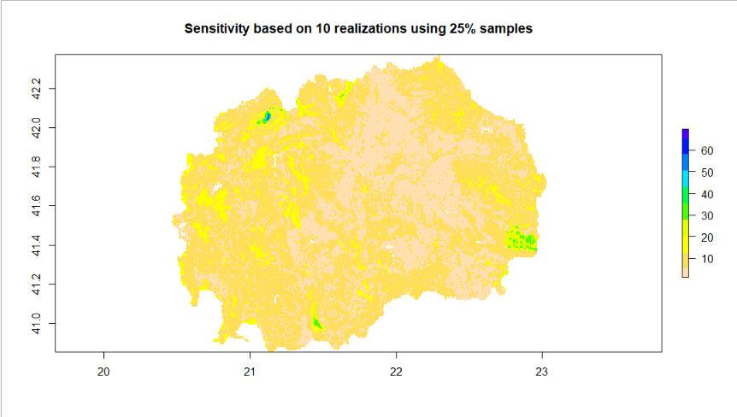
Uncertainty Random Forest
Let’s assess the model sensitivity to the data by predicting values 10 times with 25 % of the data, randomly selected
We can generate a single sensitivity raster from the pred stack using the calc function
We can visualize the sensitivity and get and overview of the distribution of the R-squared and RMSE
# The sensitivity map is the dispersion of all individual models
sensitivity <- calc(pred, sd)
plot(sensitivity, col=rev(topo.colors(10)),
main='Sensitivity based on 10 realizations using 25% samples')
summary(validation)

Slide 15
Uncertainty Random Forest
Let’s assess the model uncertainty using quantile regression forest
In the regular Random Forest algorithm we output a prediction by taking the mean of all prediction trees
By using the Quantile Regression Forest algorithm we are not limited to outputting just the mean but also any other statistical parameter, in our case we are interested in the standard deviation of the predictions of the regression trees
This process is computationally demanding
Parallel computing using the package snow
#generate mtry variable using caret package
rfmodel<- train(fm, data=dat@data, method = "rf", trControl = ctrl,
importance=TRUE)
# run the quantile regression forest algorithm
library(quantregForest)
model <- quantregForest(y=dat@data$OCS, x=dat@data[,8:19],
ntree=500, keep.inbag=TRUE,
mtry = as.numeric(rfmodel$bestTune))

Slide 16
Uncertainty Random Forest
Total uncertainty (in percent) is represented by the sum of the quantile regression forest standard deviation and the sensitivity map
The total uncertainty is then divided by the prediction to obtain a percent map, which is easier to interpret
library(snow)
# Define number of cores to use
beginCluster()
## 8 cores detected, using 7
# Estimate model uncertainty
unc <- clusterR(covs, predict, args=list(model=model,what=sd))
# OCS prediction based in all available data
mean <- clusterR(covs, predict, args=list(model=model,what=mean))
# The total uncertainty is the sum of sensitivity and model
# uncertainty
unc <- unc + sensitivity
# Express the uncertainty in percent % (divide by the mean)
Total_unc_Percent <- unc/mean
endCluster()

Slide 17
Uncertainty Random Forest
We can plot and output our final SD layer
# Plot both maps (the predicted OCS and associated uncertainty)
plot(mean, main='OCS based in all data')
plot(unc, main='Total uncertainty')
plot(Total_unc_Percent, main='Total uncertainty in %')
writeRaster(unc, '02-Outputs/MKD_OCS_RF_sd.tif', overwrite=TRUE)

Slide 18
Validation

Slide 19
What is Validation?
No map is perfect
All maps, including soil maps, are representations of reality that are often based on an underlying model.
There is always a deviation between the phenomenon depicted on the map and the phenomenon observed in the real world, i.e. each map contains errors.
The magnitude of the errors determines the quality of the map.
If a map matches the reality well (the error is small), the quality or accuracy of the map is high.
On the other hand, if a map does not match the reality well, map accuracy is low.

Slide 20
What is Validation?
It is important that the quality of a map is determined and quantified through (statistical) validation.
Validation is defined here as an activity in which the soil map predictions are compared with observed values. From this comparison, the map quality can be quantified and summarized using map quality measures.
Quality measures obtained through validation are global measures: each quality measure gives one value for the entire map.
Note that this is different from results obtained through uncertainty assessment which is quantified for each pixel of the map.

Slide 21
Validation methods
To perform validation, we need to compare our map’s predictions with observed values which were not used for calibration of the model. This can be achieved in one of the 3 ways:
Additional probability sampling: a new soil survey to collect data from the field and compare it to the predicted values;
Advantages:
Allows to make unbiased quantification of map quality
Disadvantages:
High cost of soil survey

Slide 22
Validation methods: data splitting
2. Data splitting: use part of the data (e.g. 75%) for calibrating the model, and other part (e.g. 25%) for validating it.
Advantages:
No need for field survey
Disadvantages:
If data is sparse then difficult to split it into representative parts, and the result may be biased

Slide 23
Validation methods: data splitting
During the data preparation we already split our initial dataset into training data - for calibration of the model, and test data - for validation:
library(caret)
# Define the random numbers table (to get reproducible result)
set.seed(11042019)
# Create random selection of 75% of the data as 'train' dataset and
# 25% as 'test' dataset
train.ind <- createDataPartition(1:nrow(dat), p = .75, list = FALSE)
train <- dat[ train.ind,]
test <- dat[-train.ind,]

Slide 24

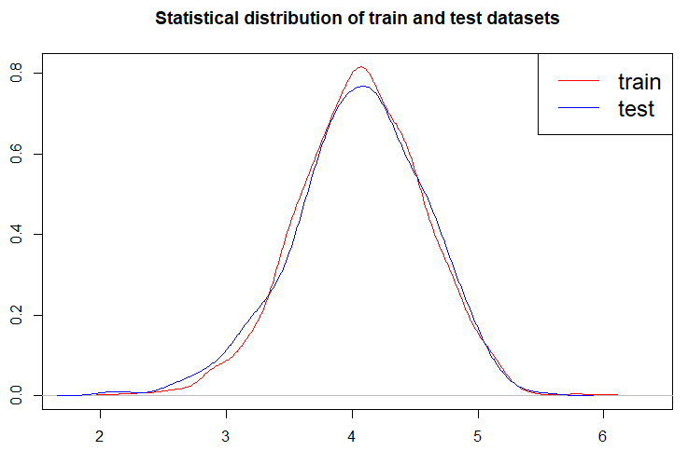
Validation methods: data splitting
When splitting the dataset it is important to ensure that the distribution is same both for calibration (training) data, and for validation (testing) data, in order to minimize bias.

Slide 25
Validation methods: cross-validation
3. K-fold Cross-validation: the dataset is split into K (e.g. 10) roughly equal sets (folds), then for each set a model is calibrated. Validation results are then summarised for all folds.
Advantages:
Uses all data for both calibration and validation - better than splitting when the data is limited
Disadvantages:
Like data splitting, it may be biased
Needs more time and computational power to run multiple models.
Example R codes for cross-validation using caret package are available in the SOC mapping Cookbook (FAO, 2018)

Slide 26

Validation in R
Let’s create a script for validation in R
# Set working directory
setwd("C:/Users/hp/Documents/FAO/EduSoils/training_material")
library(raster)
# Load and stack the maps from the results folder
RKmap<-raster("02-Outputs/MKD_OCS_RK.tif")
RFmap<-raster("02-OutputsMKD_OCS_RF.tif")
maps <- stack(RKmap, RFmap)
# Explore the maps
names(maps)
summary(maps)
plot(maps)

Slide 27
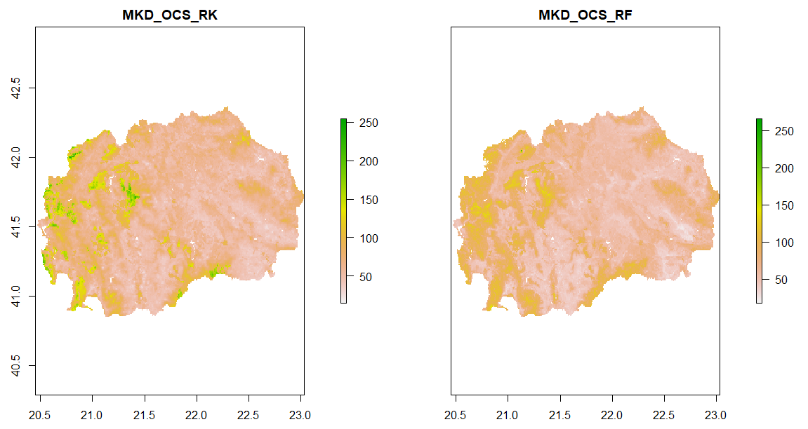

Slide 28
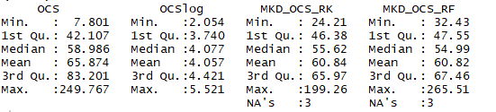
Extracting predictions to points
# Load the validation dataset.
# It was was prepared in the 'data_preparation_profiles' script
test <- read.csv("02-Outputs/dat_test.csv")
# Promote to spatialPointsDataFrame and set crs
coordinates(test) <- ~ X + Y
test@proj4string <- CRS(projargs = "+init=epsg:4326")
# Extract the predicted values from the maps to the validation dataset
test <- extract(x = maps, y = test, sp = TRUE)
summary(test)

Slide 29
Prediction errors
# Remove NA values
test<-as.data.frame(test)
test <- test[complete.cases(test),]
Prediction Errors (PE) are a difference between predicted (on the map) and observed (true) values:
PE = Predicted - Observed
# Calculate prediction errors
test$PE_RK <- test$MKD_OCS_RK - test$OCS
test$PE_RF <- test$MKD_OCS_RF - test$OCS

Slide 30
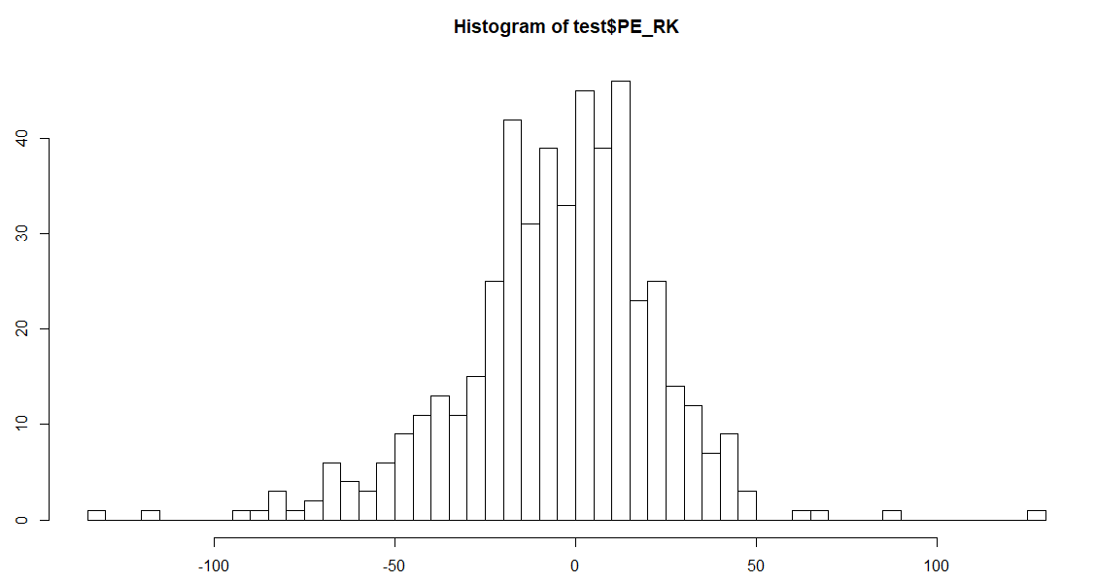
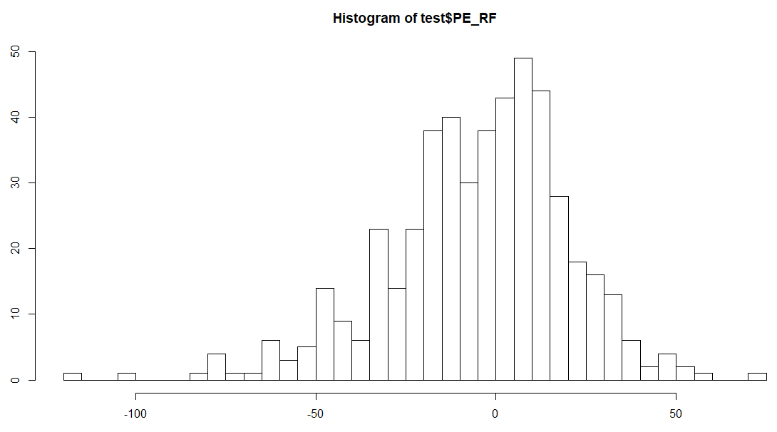

Prediction errors
# Explore prediction errors
summary(test$PE_RK)
summary(test$PE_RF)
hist(test$PE_RK, breaks=50)
hist(test$PE_RF, breaks=50)

Slide 31
Map quality measures
We will use the following map quality measures:
Mean error (ME)
Mean Absolute Error (MAE)
Root Mean Squared Error (RMSE)
Amount of Variance Explained (AVE)
Mean error (ME) is defined as the population mean (spatial mean) of the prediction errors. ME measures bias in the predictions.
ME should be (close to) zero, which means that predictions are unbiased meaning that there is no systematic over- or under-prediction of the soil property of interest.

Slide 32
Map quality measures
Mean absolute error (MAE) and mean squared error (MSE) are measures of map accuracy and indicate the magnitude of error we make on average. The MAE is defined by the population mean of the absolute errors, and the MSE by the population mean of the squared errors.
Many authors report the root mean squared error (RMSE) instead of the MSE, which is computed by taking the square root of the MSE. The RMSE can be a more appealing quality measure since it has the same unit of measurement as the mapped property and, therefore, can be more easily interpreted.

Slide 33
Map quality measures
Amount of Variance Explained (AVE) is the measure of model efficiency. AVE quantifies the fraction of the variation in the data that is explained by the prediction model.
AVE is similar to R-squared (R²) of the model. The maximum value of AVE is 1 (meaning that the model describes 100% of variation)
AVE measures the improvement of the model prediction over using the mean of the data set as predictor. In case the AVE is negative (<0), then the mean of the data set is a better predictor than the prediction model.

Slide 34

Calculating map quality measures
# Regression Kriging
# Mean Error
ME_RK <- mean(test$PE_RK)
# Mean Absolute Error (MAE)
MAE_RK <- mean(abs(test$PE_RK))
# Root Mean Squared Error (RMSE)
RMSE_RK <- sqrt( sum(test$PE_RK^2) / length(test$PE_RK) )
# Amount of Variance Explained (AVE)
AVE_RK <- 1 - sum(test$PE_RK^2) / sum( (test$OCS - mean(test$OCS))^2 )

Slide 35
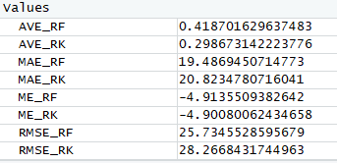
Calculating map quality measures
# Random Forest
# Mean Error
ME_RF <- mean(test$PE_RF)
# Mean Absolute Error (MAE)
MAE_RF <- mean(abs(test$PE_RF))
# Root Mean Squared Error (RMSE)
RMSE_RF <- sqrt(sum(test$PE_RF^2) / length(test$PE_RF))
# Amount of Variance Explained (AVE)
AVE_RF <- 1 - sum(test$PE_RF^2) / sum( (test$OCS - mean(test$OCS))^2 )

Slide 36
Summary Tabel
table <- data.frame(Quality_measure = c("AVE", "MAE", "ME","RMSE"))
table$RKmap <- c(AVE_RK, MAE_RK, ME_RK, RMSE_RK)
table$RFmap <- c(AVE_RF, MAE_RF, ME_RF, RMSE_RF)
table

Slide 37
Validation
Clay

Slide 38
Thank you!

